Slide 1
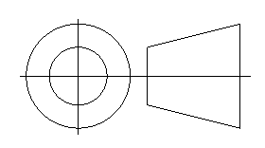
Making Custom Symbols in SolidWorks
For Drawings and Annotations
By: Matthew Lorono
Drawings Definition Product Manager
DS SolidWorks Corp

Slide 2

Making Custom Symbols in SolidWorks
Symbols for drawings and annotations
SolidWorks has many standard symbols for annotations.
This include symbols such as Centerline, Diameter, Plus/Minus, Counterbore, Profile, etc.

Slide 3
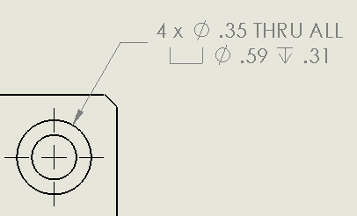
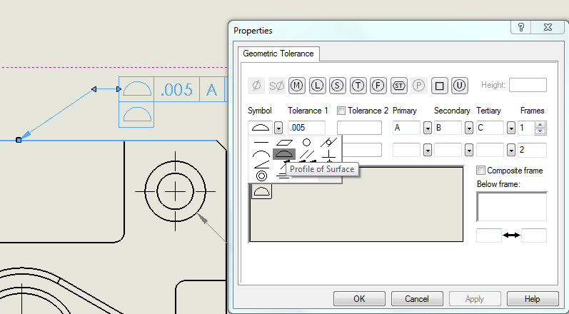
Making Custom Symbols in SolidWorks
Some symbols are added automatically to annotations and dimensions, such as:
Diameter and Counterbore in hole callouts.
Geometric Tolerance symbols are in feature control frames.

Slide 4
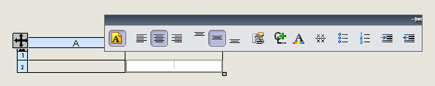
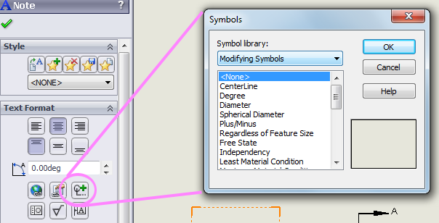
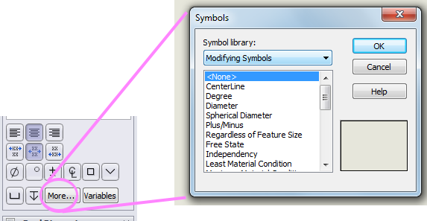
Making Custom Symbols in SolidWorks
Symbols may be added to most annotations and dimensions with Symbols button
Symbols button is available for:
  Annotations
  Tables
  Dimensions, Hole Callouts and other areas as “More…”

Slide 5
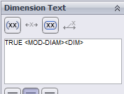


Making Custom Symbols in SolidWorks
Symbols are inserted as tags into annotations and dimensions
<MOD-DIAM>
Category Symbol
This is what you see in Dimension edit field and in the Edit Text in Window dialog.

Slide 6
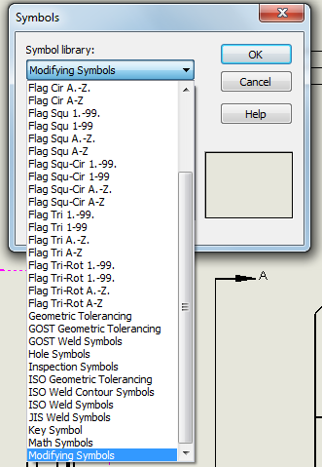
Making Custom Symbols in SolidWorks
Symbols are organized on a file called GTOL.SYM
Symbols are divided into categories within the GTOL.SYM, such as Hole Symbols, Geometric Tolerancing, etc
GTOL.SYM is located in the <install folder>\lang\english
  Example: C:\Program files\SolidWorks Corp\SolidWorks\lang\english\GTOL.SYM

Slide 7

Making Custom Symbols in SolidWorks
Use Notepad to edit GTOL.SYM
GTOL.SYM is a text file that can be edited with any text file editor, such as Notepad.
Categories of symbols are grouped together in the file, similar to how they are displayed in the Symbol dialog.
          ;; ---------------------------------------------------------------------------
          ;; Geometric Tolerancing Symbols (per ASME Y14.5-1994)
          #GTOL,Geometric Tolerancing
          *ANGULAR,Angularity
          A,LINE .0,.072,1.5,.938
          A,LINE .0,.072,1.5,.072
          *BETW,Between
          A,POLY .0,.5,.8,.2,.8,.8
          A,LINE .8,.5,2.2,.5
          A,POLY 2.2,.2,2.2,.8,3.,.5
          *CIRC,Circularity(roundness)
          A,CIRCLE .75,.5,.75

Slide 8
Making Custom Symbols in SolidWorks
Each row of text in GTOL.SYM starts with an identification
Semi-Colon “ ; ” is a comment row (ignored). Rows that begin with a semi-colon are generally used as dividers between categories.
Pound “ # ” is the start of a category. This row consists of a tag name, followed by a comma and the full name of the category. All symbols that follow a particular pound row are a part of that category.
Asterisk “ * ” is the start of a symbol. This row consists of a tag name, followed by a comma and the full name of the symbol.
Letter “ A ” identifies a row that defines a portion of the geometrical shape of a symbol. Symbols may have more than one A row.

Slide 9
Making Custom Symbols in SolidWorks
Shapes used to make symbols are simple
Symbols must be simple geometric shapes formed with lines, arcs, circles, polylines and alphanumeric characters, in the following formats:
A,LINE xStart,yStart,xEnd,yEnd
A,CIRCLE xCenter,yCenter,radius
A,ARC xCenter,yCenter,radius,startAngle,endAngle
A,SARC xCenter,yCenter,radius,startAngle,endAngle
A,TEXT xLowerLeft,yLowerLeft,<letter(s)>
A,POLY x1,y1,x2,y2,x3,y3

Slide 10
Making Custom Symbols in SolidWorks
Symbols are defined on a 1,1 square grid
Symbols exist on an imaginary grid space where 0,0 is the lower left corner and 1,1 is the upper right corner.
Symbols are not limited to this grid space. Larger numbers than 1.0 are allowed. Negative numbers also work.
1.0 represents the height of a font as it is used in SolidWorks. An uppercase letter is slightly smaller then 1.0
E
1,1
0,0

Slide 11
Making Custom Symbols in SolidWorks
Task: Create 3rd angle projection symbol
Sketch the new symbol on a grid.
1.3,.75
1.88,.08
0.5, 0.5
X=0.5, Y=1
.25 radius
1,1
2,1
X=0 Y=0.5
X=2 Y=0.5
0,0
X=0.5, Y=0
1.3,.25
1.88,.08
.46 radius

Slide 12
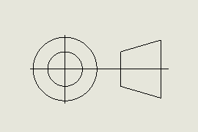
Making Custom Symbols in SolidWorks
Let’s try this
*Third,Third Angle Projection
A,Circle .5,.5,.46
A,Circle .5,.5,.25
A,Line 0,.5,2,.5
A,Line .5,0,.5,1
A,Line 1.3,.75,1.88,.92
A,Line 1.3,.25,1.88,.08
A,Line 1.3,.25,1.3,.75
A,Line 1.88,.08,1.88,.92
X is not 1.3

Slide 13
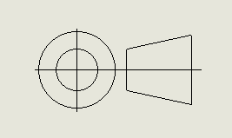
Making Custom Symbols in SolidWorks
Let’s make adjustments and try this
*Third,Third Angle Projection
A,Circle .5,.5,.46
A,Circle .5,.5,.25
A,Line 0,.5,2,.5
A,Line .5,0,.5,1
A,Line 1.1,.75,1.88,.92
A,Line 1.1,.25,1.88,.08
A,Line 1.1,.25,1.1,.75
A,Line 1.88,.08,1.88,.92
Try 1.1 instead of 1.3 for X

Slide 14
Making Custom Symbols in SolidWorks
To affect changes to existing symbols, SolidWorks must be closed and restarted
SolidWorks loads the GTOL.SYM file at the time of launch. It is not reloaded during the session.
This means that SolidWorks must be exited and restarted in order to see updates to symbols in the GTOL.SYM file.

Slide 15
Making Custom Symbols in SolidWorks
Take note:
Each person who uses your documents will need to have their own copy of your custom GTOL.SYM in their local SolidWorks install folder.
Always make backup copies of content files that you edit!
  Backup originals!
  Backup your custom edits too!

